Slide 1
Can you predict diabetes?

Slide 2
Outline
Introduction
Descriptive Statistics
Machine Learning
Results
Final Takeaways

Slide 3
Diabetes
Affects a large number of people all over the world
Focusing largely on Type 2 Diabetes

Slide 4
Pima Indians dataset
Collected in the mid to late 90s in Phoenix, Arizona
768 observations on 9 variables

Slide 5
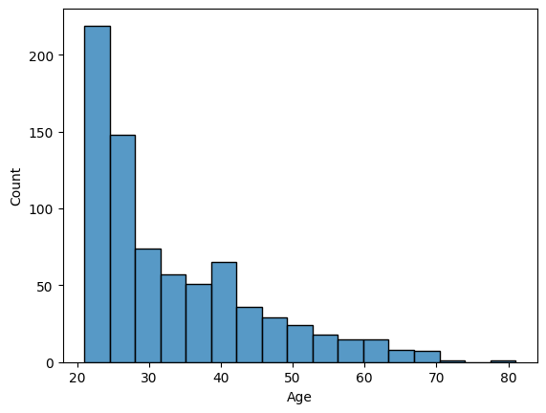
Age Distribution of Pima Indians

Slide 6
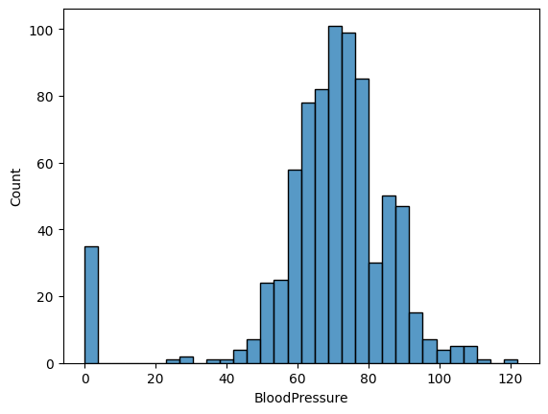
Blood Pressure distribution

Slide 7
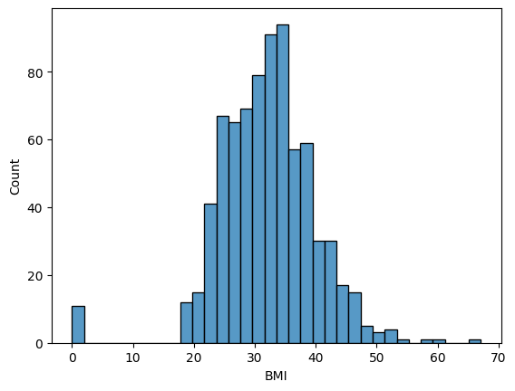
BMI distribution

Slide 8
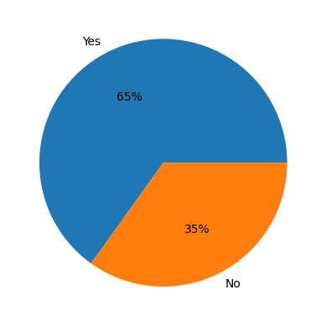
Diabetes Spread

Slide 9
Machine Learning
Models Chosen:
Naïve Bayes
Decision Tree
Untuned and Tuned

Slide 10
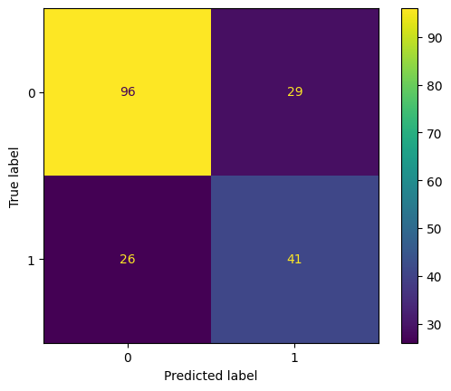
Naïve Bayes
Gaussian Naïve Bayes model was chosen
75/25 split used for training
Accuracy: 0.714
Precision: 0.586
Recall: 0.612
F1 Score: 0.599

Slide 11
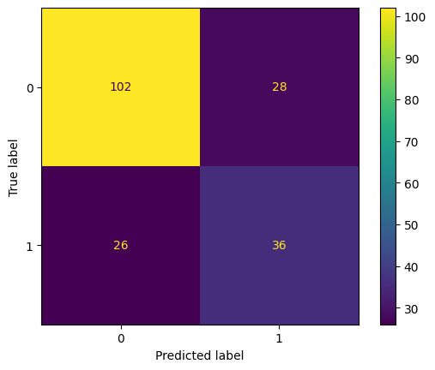
Decision Tree
Variables were minmax scaled
Untuned
Accuracy: 0.719
Precision: 0.562
Recall: 0.581
F1 Score: 0.571

Slide 12
Decision Tree
Variables were minmax scaled
Tuned
Accuracy: 0.73955
Precision: 0.646482
Recall: 0.631475
F1 Score: 0.633318

